Slide 1

CSC 533: Privacy in the Digital Age (Fall 2020) Final Exam : Review
Anupam Das
Nov.17, 2020

Slide 2
Final Exam format
Format
Short questions (total 8-9 questions with one being a bonus question)
2 hour exam (Online: submitted through Moodle)
Time restricted: Opens at Nov 19, 9am and closes at 11am.
Mostly new content
Submit PDF only (you can use word or even print the script and handwrite the answer, but everything should be submitted in PDF format in one file)
Template questions for you to better prepare (similar to midterm):
Explain how approach X works? How is it different from approach Y?
What are the limitations of X and how does Y resolve it?
Demonstrate how X works. [with illustrative example]
Construct a solution for the following scenario. Open-ended questions.
Compare X with Y under this scenario.
What is the tradeoff of X and Y?
Important: Look at assignments and class discussions

Slide 3
Review Topics
Membership Inference attack
How antiparticles anonymize the data when adding up in federated learning
Double spending attack
How hash functions work under attack
Bitcoin privacy issues
Network inference attacks
Acoustic and motion sensor based inference attacks

Slide 4
Topics
Membership Inference attack

Slide 5
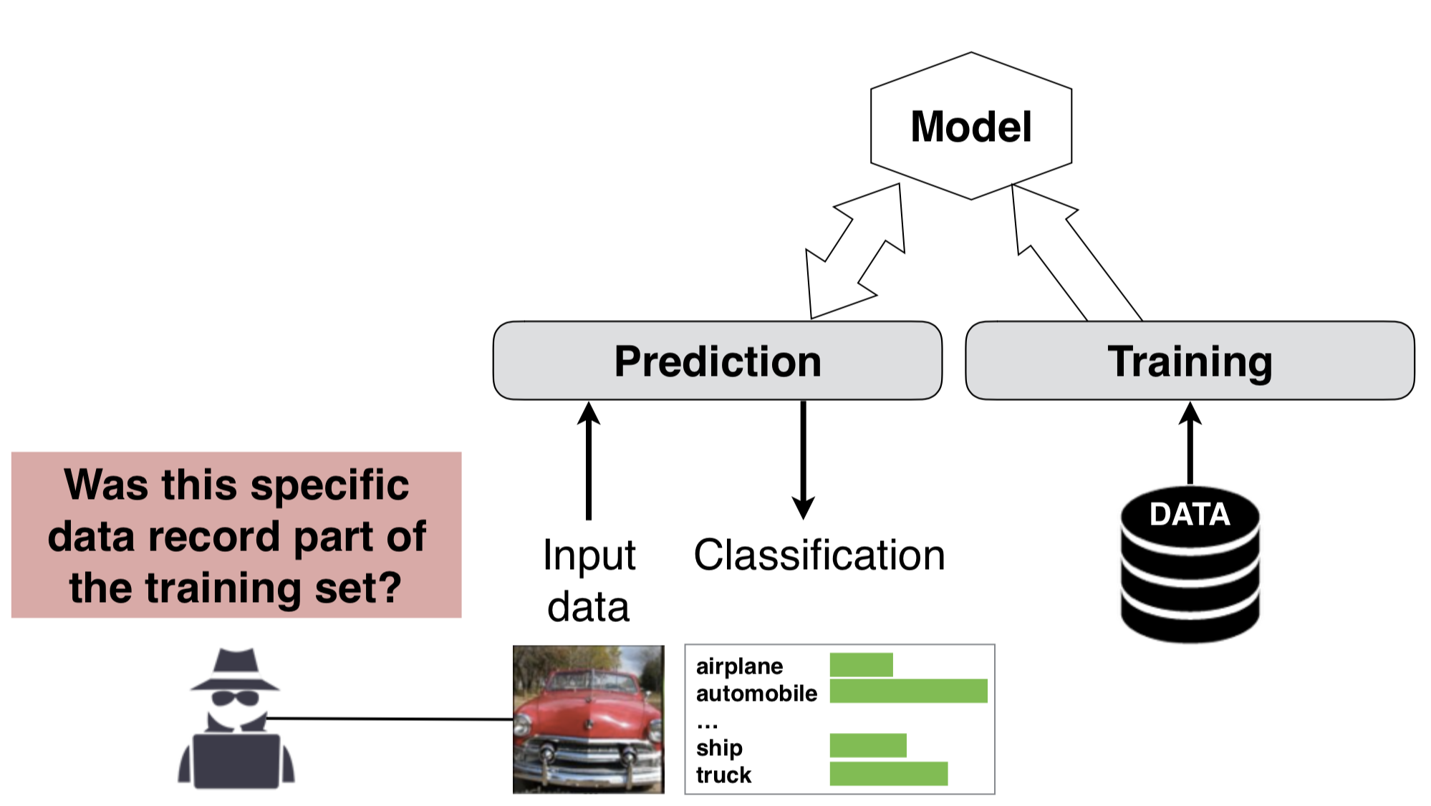
Membership inference attack

Slide 6
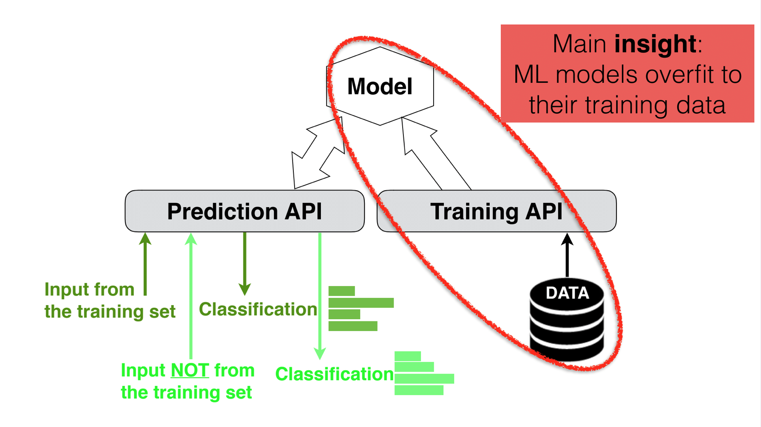
Attack Overfitted Models

Slide 7
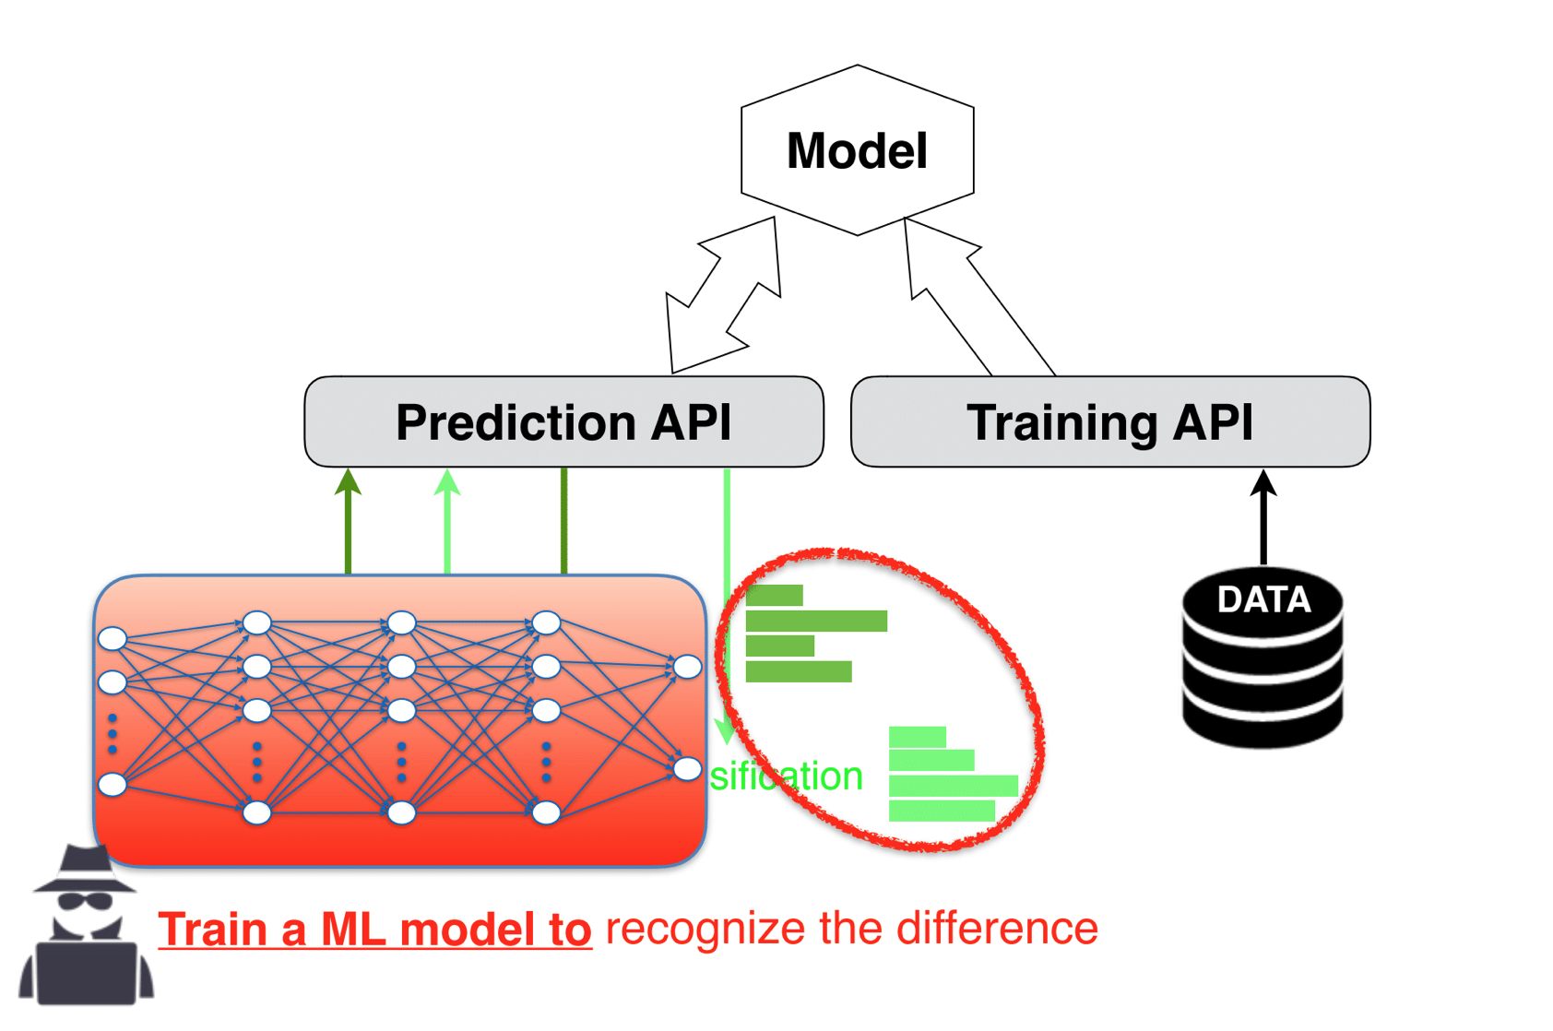
ML against ML

Slide 8
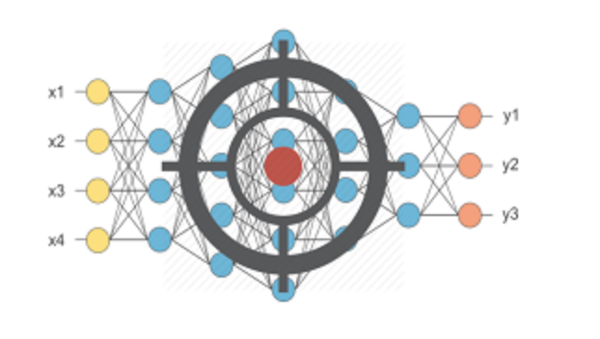
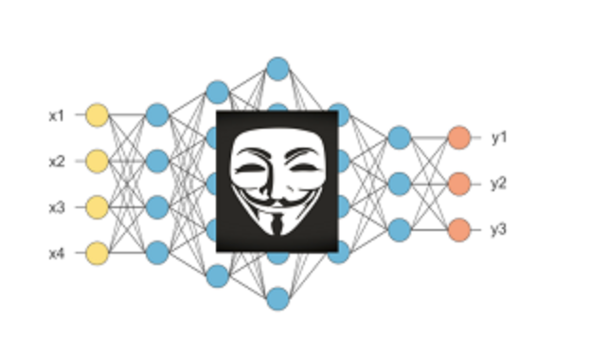
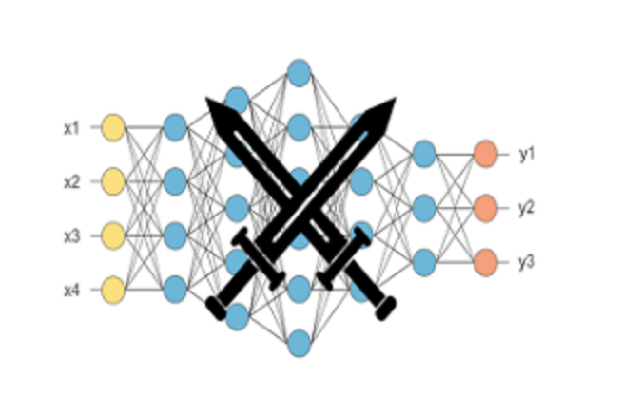
Different Models needed
Target Model (the one that a cloud service build’s):
Input: Data that you want to analyze
Output: Class prediction probability and final prediction
Shadow Model:
Input: Data from the same input distribution
Output: Class prediction probability and final prediction
Attack Model:
Input: class prediction probability
Output: member or not-member

Slide 9
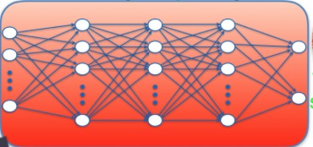

The Attack Model
Input: (original features, predicted class label, predictions by the target model)
e.g. (x₁, x₂, ..., x_{m}, y, p₁, p₂, ..., p_{k})
Output: in / out
x₁, x₂, ..., x_{m} = input vector
Y= output classification label
p₁, p₂, ..., p_{k} = prob. of each class label
How should we train the attack model?

Slide 10
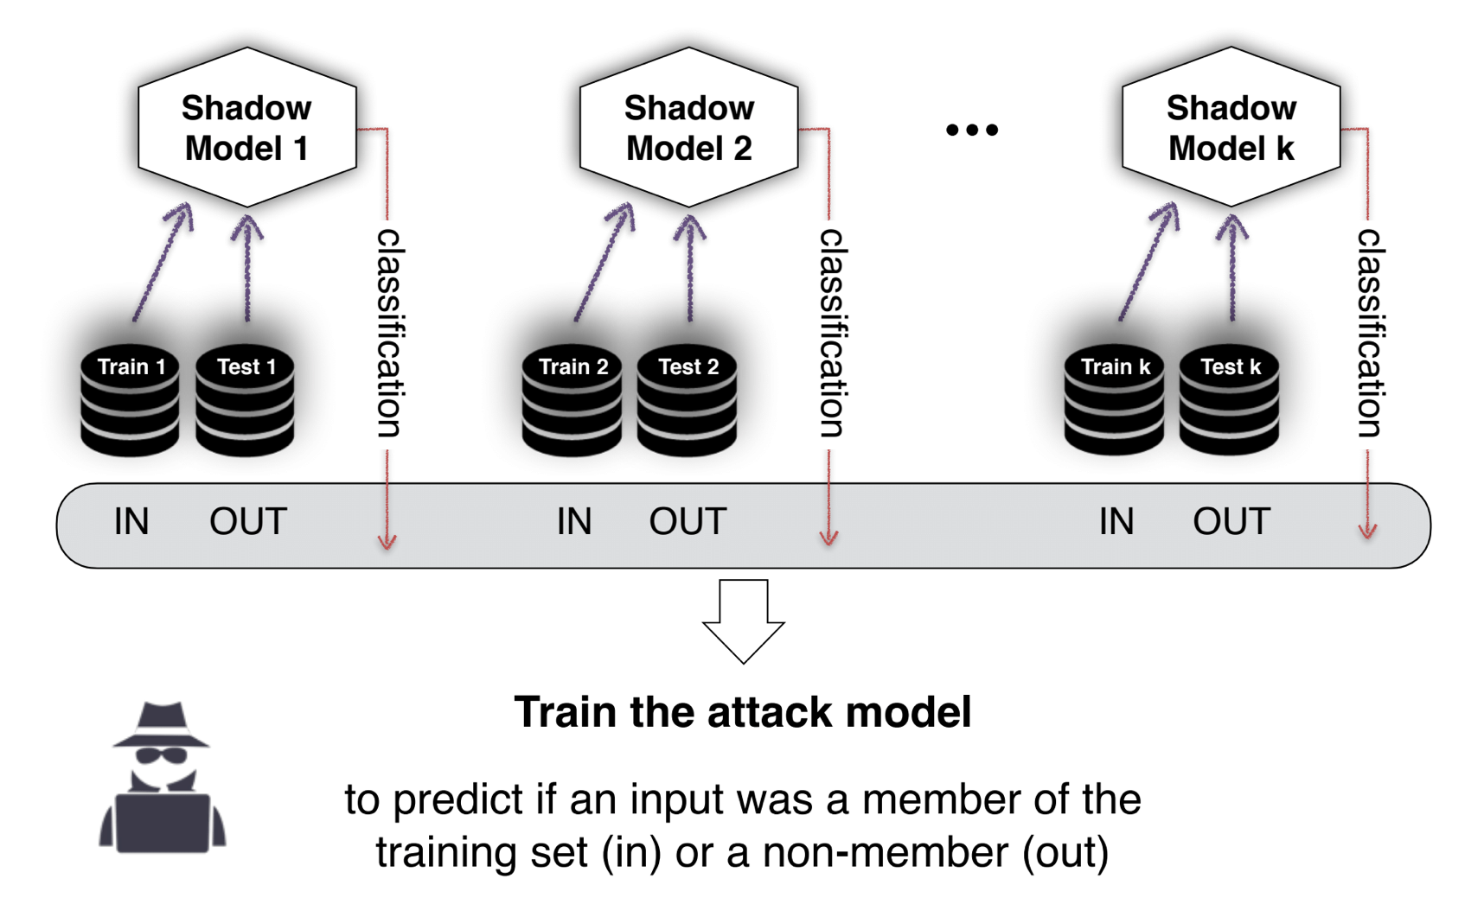
Shadow Models
Training data are sampled from the same distribution as the target training data
Have the same structure as the target model

Slide 11
Obtaining Training Data for Shadow Models
Real
Similar to training data of the target model (i.e., drawn from same distribution, if known)
Synthetic
Use a sampling algorithm to obtain data classified with high confidence by the target model

Slide 12
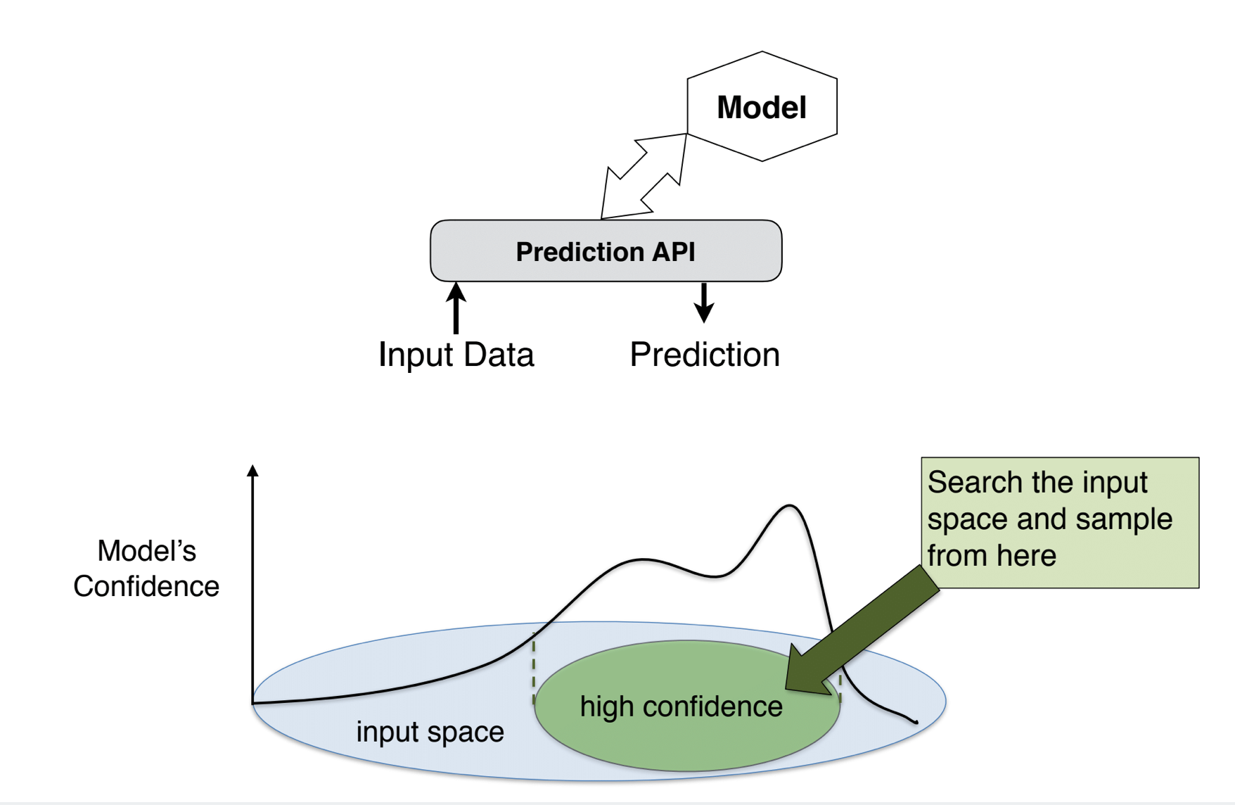
Synthesis using the target model
Target inputs

Slide 13
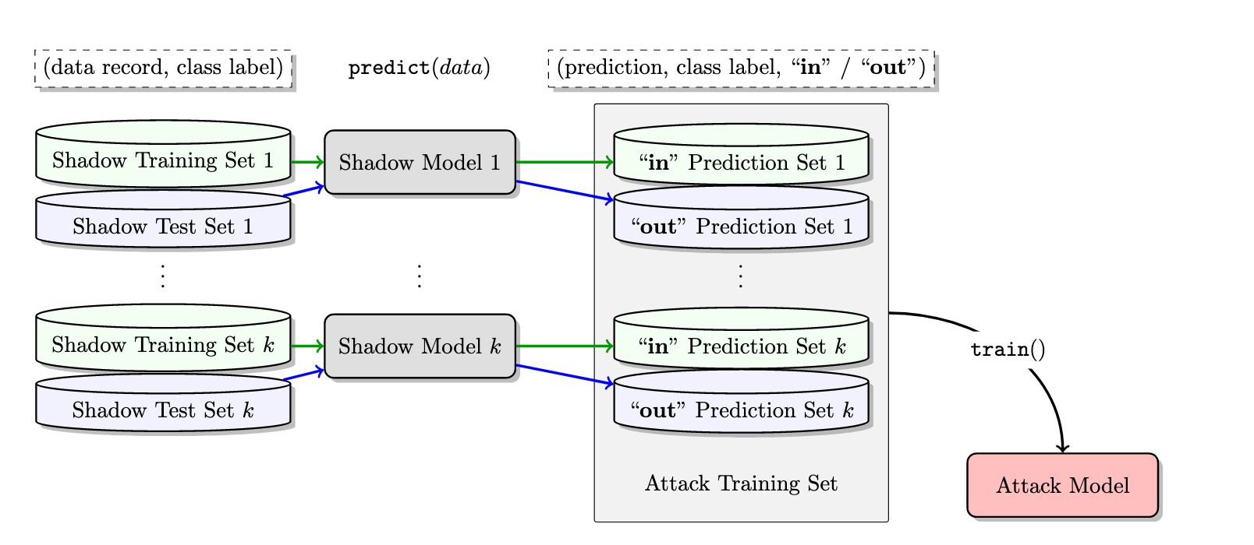
Shadow Models
Attack model training:
input feature output label
<prediction vector, class label> <in or out>
Prediction vector: [<prob., class label, confidence> …]

Slide 14
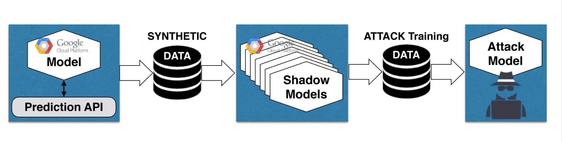
Constructing the Attack Model
Step 1: Generate Synthetic Data
Step 2: Train Shadow Models
Step 3: Train the Attack Model
Membership Inference Attacks Against Machine Learning Models. Reza Shokri ; Marco Stronati ; Congzheng Song ; Vitaly Shmatikov IEEE SP 2017

Slide 15
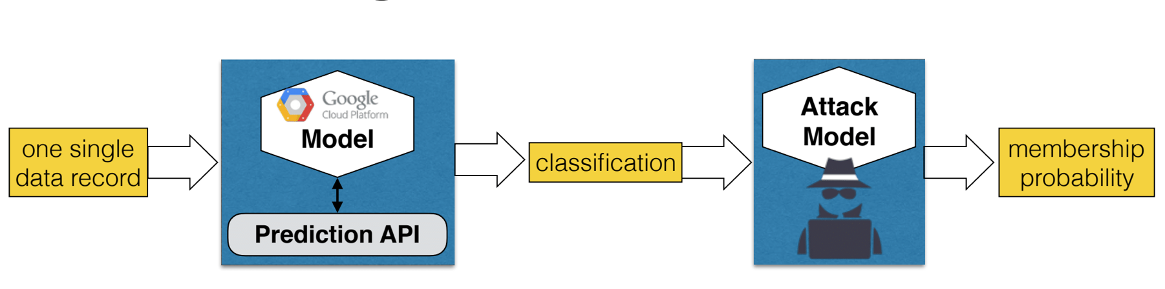
Using the Attack Model
Step 1: Get the prediction vector on the target record
Step 2: Get the prediction of the attack model

Slide 16
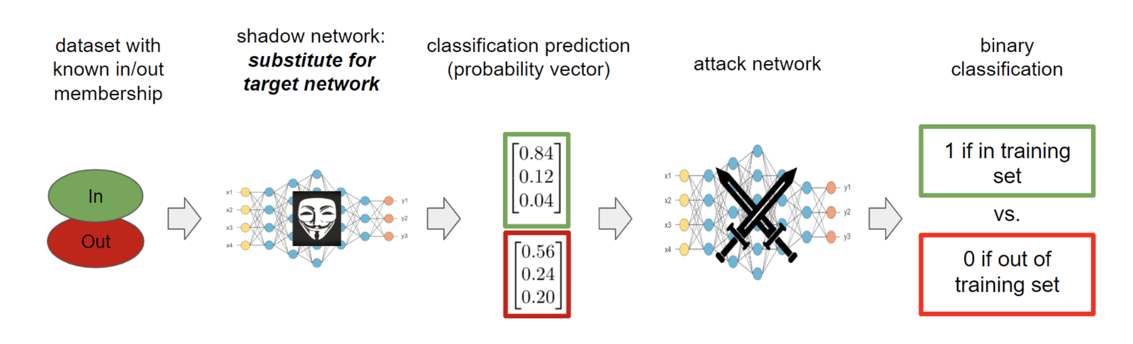
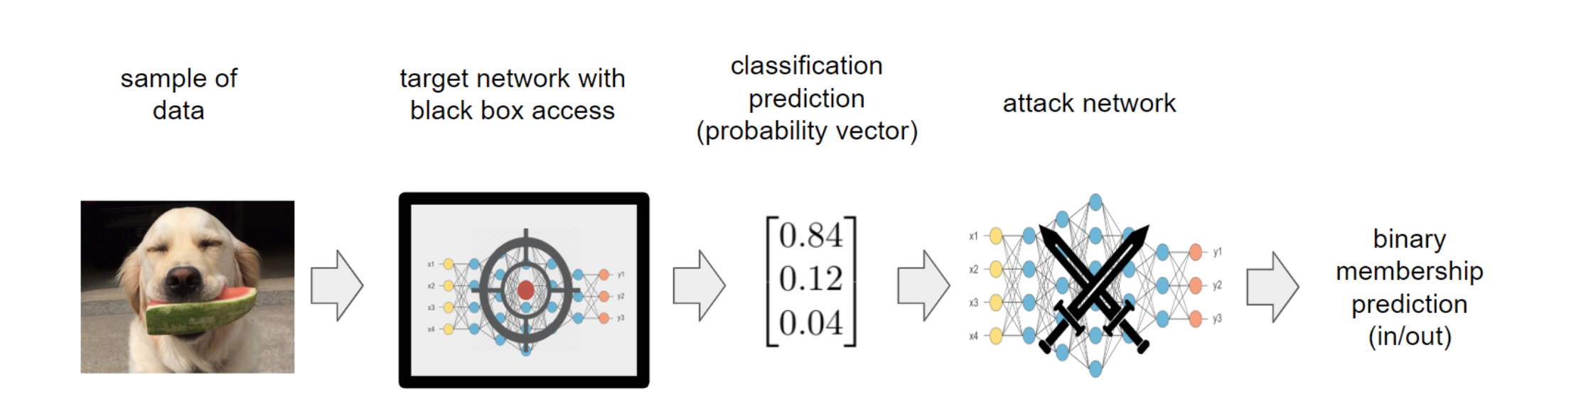
Another illustration

Slide 17
Topics
How antiparticles anonymize the data when adding up in federated learning?

Slide 18
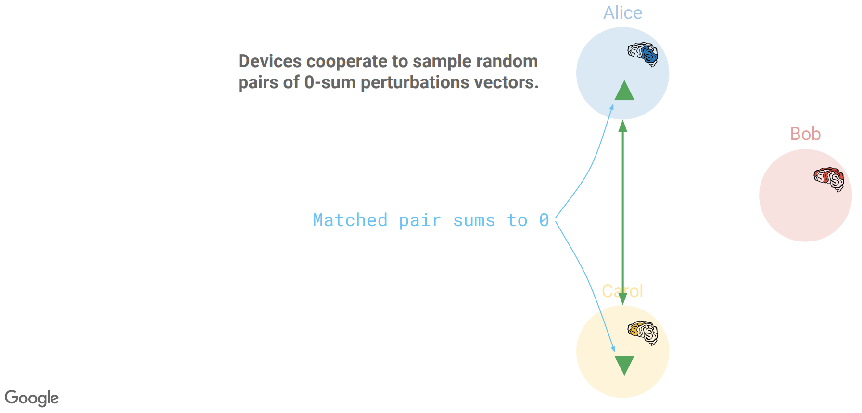
Random positive/negative pairs, aka antiparticles

Slide 19
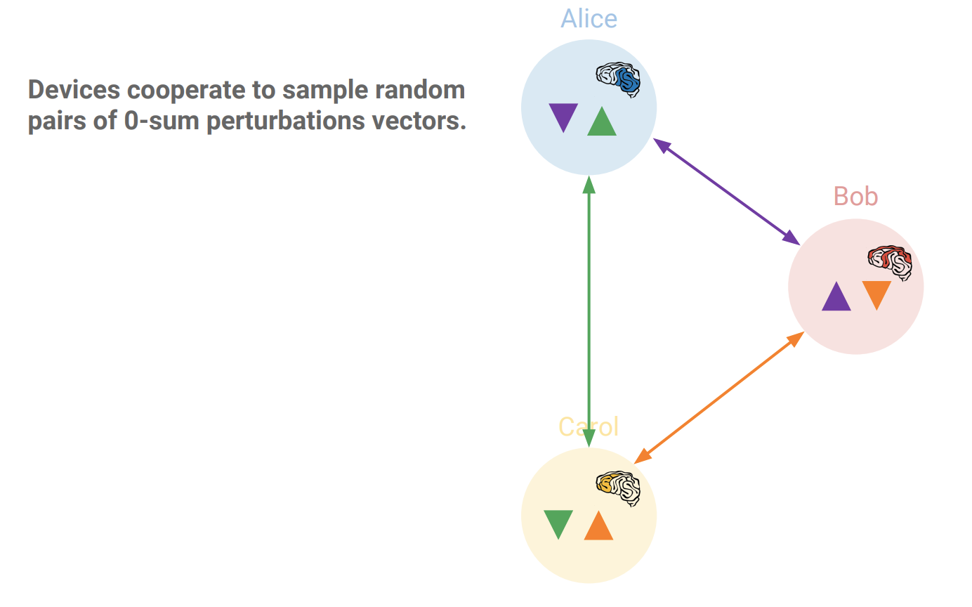
Random positive/negative pairs, aka antiparticles …

Slide 20
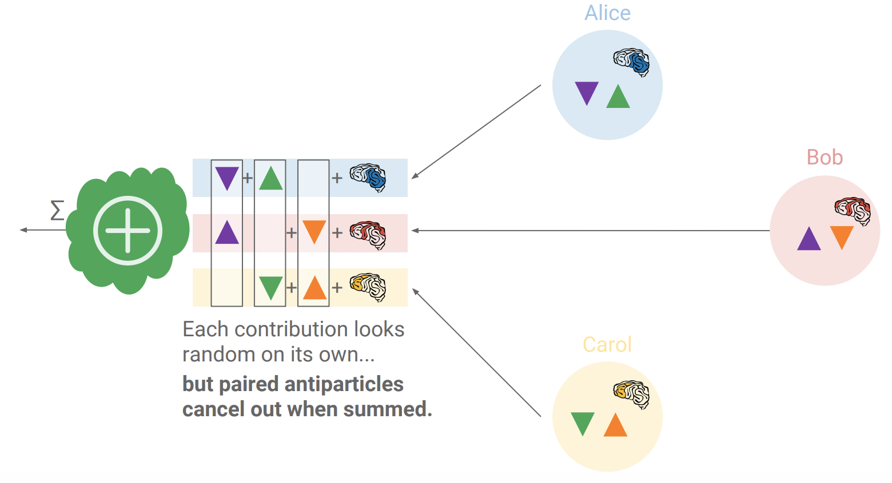
The antiparticles cancel when summing contributions
Can use secret sharing techniques to count for faulty nodes
See: http://jakubkonecny.com/files/2018-01_UW_Federated_Learning.pdf

Slide 21
Topics
Bitcoin
How hash functions work under attack?
Double spending
Privacy issues

Slide 22
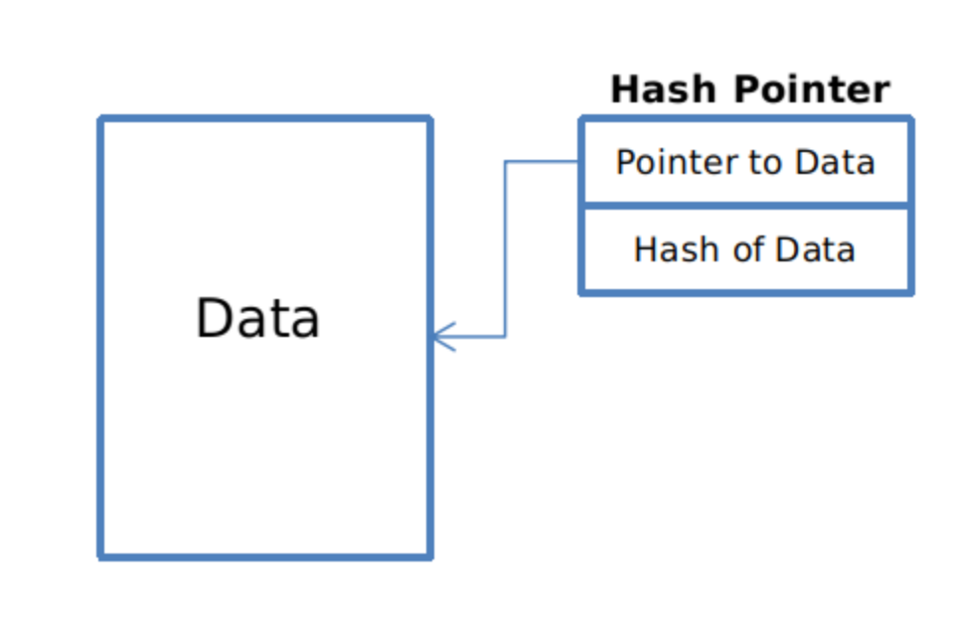
Hash pointers
hash pointer is:
* pointer to where some info is stored, and
* (cryptographic) hash of the info
if we have a hash pointer, we can
* ask to get the info back, and
* verify that it hasn’t changed
H( )
(data)
will draw hash pointers like this
22

Slide 23
Blockchain of hash pointers
H( )
linked list with hash pointers = “block chain”
prev: H( )
prev: H( )
prev: H( )
data
data
data
use case: tamper-evident log
23

Slide 24
Detecting tampering
H( )
prev: H( )
prev: H( )
prev: H( )
data
data
data
use case: tamper-evident log
24

Slide 25
Double spending attempts
1 confirmation
3 confirmations
C_{A} → B
Double-spend probability decreases exponentially with # of confirmations
Most common heuristic: 6 confirmations
Works only if 50% of the nodes are honest
C_{A} → A’
double-spend attempt
Honest nodes will extend the longest valid branch

Slide 26
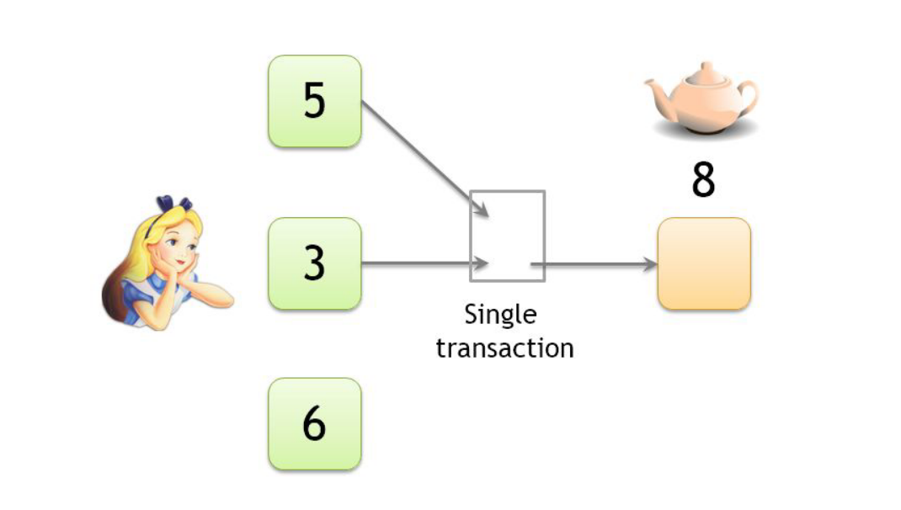
Linking pseudonyms
Both inputs must belong to the same person
The wallet will require the keys to generate the transaction
Lecture: https://youtu.be/glyQy_e5LmM?t=1758

Slide 27
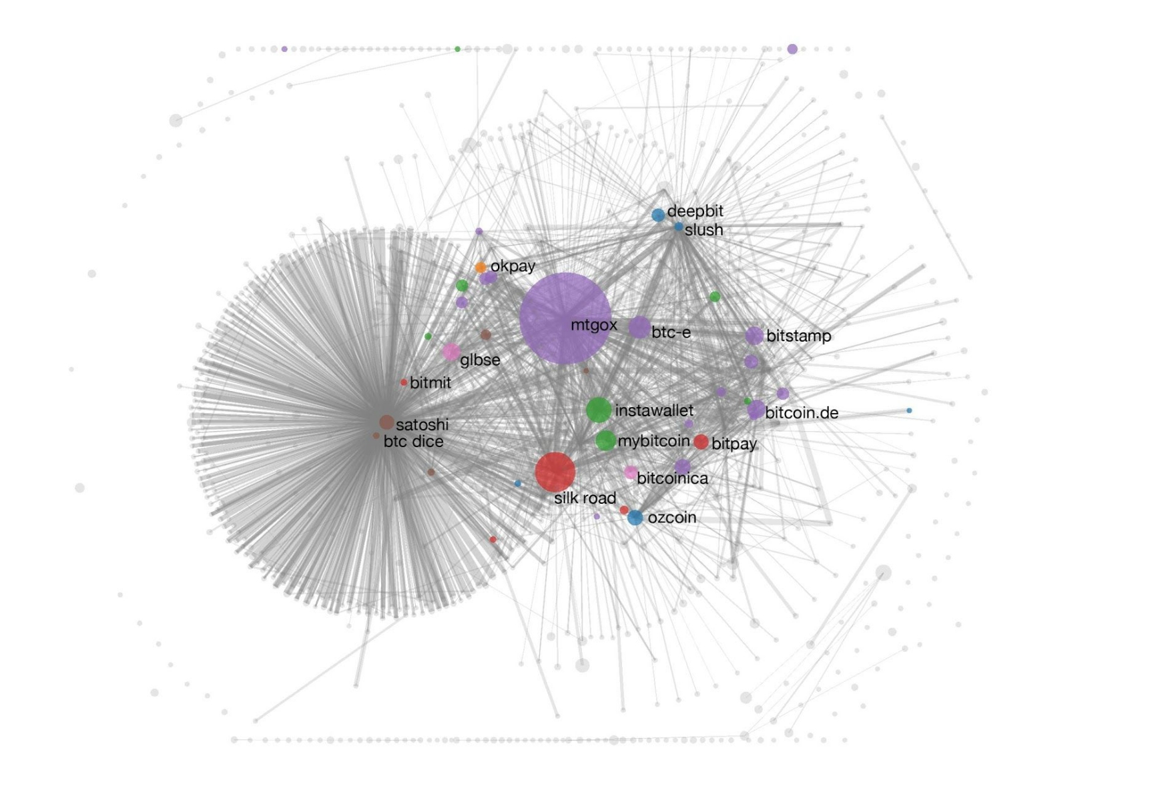
Deanonymization attacks
Transaction graph (plus side channel information) can link pseudonyms to real/online identities
​Paper: A Fistful of Bitcoins: Characterizing Payments Among Men with No Names

Slide 28
Topics
Network inference attacks

Slide 29
Inference attacks on networked devices
Remote physical device fingerprinting
TCP based clock skew rate
How do you get the clock skew?
Website fingerprinting
Over encrypted data
What features?
IoT device activity
Over encrypted data
What features?

Slide 30
Topics
Acoustic and motion sensor based inference attacks

Slide 31
Acoustics and motion sensor based inference attacks
Acoustic side channels
Keystroke
Acoustic sounds generated by keystrokes
3D printed object
Acoustic sound from different primitive operations like stepper motors
Magnetic field of motors
inaudible voice commands
Non-linear property of amplifier (aliasing)
Motion sensor based side channels
speech recognition
Signal aliasing (mapping high freq. signals to lower freq. components
route/location
Detection orientation change and then overlay real map

Slide 32
Logistics
Final project report
If you haven’t shared data and code you will be deducted points
Do it by today!
Final Exam On Nov 19 (9am-11am) on Moodle
Keep time to upload the final PDF
Class evaluation (please complete)
http://go.ncsu.edu/cesurvey
Go and fill out the survey after class (requires 2-3 mins)

Slide 33
Course feedback
What things you like?
What things you didn’t like?

